Slide 1
Chapter 4
How to use CSS to format the elements of a web page

Slide 2
Objectives
Applied
Given an HTML document, create a CSS style sheet for formatting the web page using any of the types of selectors or rules that are presented in this chapter.
Given an HTML document with one or more CSS style sheets applied to it, use the developer tools for your browser to inspect the styles.
Given a selector in the CSS for an HTML document, describe what the selector applies to.
Knowledge
Describe three ways to include CSS in a web page.
Explain why it’s usually best to use an external style sheet for formatting a page.

Slide 3
Objectives (continued)
Describe the purpose of the normalize.css style sheet.
Distinguish between absolute and relative units of measurement.
Describe three ways to specify color in CSS, and describe how CSS3 expands upon that.
Describe these types of selectors: universal, type, id, class, descendant, child, sibling, pseudo-class, and pseudo-element.
Describe one accessibility guideline for using pseudo-class selectors.
Explain how user style sheets, !important rules, and specificity are used in the cascade order for applying style rules.
Describe these properties for styling fonts: font-family, font-style, font-weight, font-size, and line-height.
Describe these properties for formatting text: text-indent, text-align, text-decoration, and text-shadow.

Slide 4
Three ways to provide styles
Use an external style sheet by coding a link element in the head section
<link rel="stylesheet" href="styles/main.css">
Embed the styles in the head section
<style>
body {
font-family: Arial, Helvetica, sans-serif;
font-size: 100%; }
h1 { font-size: 250%; }
</style>
Use the style attribute to apply styles to a single element
<h1 style="font-size: 500%; color: red;">Valley Town Hall</h1>

Slide 5
The sequence in which the provided styles are applied
Styles from an external style sheet
Embedded styles
Inline styles

Slide 6
A head element that includes two style sheets
<head>
<title>San Joaquin Valley Town Hall</title>
<link rel="stylesheet" href="../styles/main.css">
<link rel="stylesheet" href="../styles/speaker.css">
</head>
The sequence in which the styles are applied
From the first external style sheet to the last

Slide 7
How to download and use normalize.css
http://necolas.github.io/normalize.css/
Open a browser, browse to the URL shown above, and click the Download button.
Save the normalize.css file to your web server.
Once you save the normalize.css file to your website, you can code a link element for it in each page.
What the normalize.css style sheet does
Normalize.css makes minor adjustments to browser defaults so all browsers render HTML elements the same way.
It also sets the default font family to sans-serif.

Slide 8
Common units of measure
px
pt
em
rem
%

Slide 9
The HTML for a web page that will have borders
<body>
<header>
<h1>San Joaquin Valley Town Hall</h1>
</header>
<main>
<p>Welcome to San Joaquin Valley Town Hall. We have some fascinating speakers for you this season!</p>
</main>
</body>

Slide 10
CSS that uses relative units of measure with a fixed border
body {
font-size: 100%;
margin-left: 2em;
margin-right: 2em; }
header {
padding-bottom: .75em;
border-bottom: 3px solid black;
margin-bottom: 0; }
h1 {
font-size: 200%;
margin-bottom: 0; }

Slide 11

The web page with borders in a web browser

Slide 12
Three ways to specify colors
With a color name
color: silver;
With an RGB (red-green-blue) value
color: rgb(100%, 40%, 20%);
color: rgb(255, 102, 51); /* Using multiples of 51 from 0 to 255 */
With an RGB value that uses hexadecimal numbers
color: #ffffff; /* This color is white */
color: #000000; /* This color is black */
color: #ff0000; /* This color is red */

Slide 13
CSS that uses hexadecimal values for colors
body {
font-size: 100%;
margin-left: 2em;
background-color: #FFFFCC; } /* This could also be coded as #FFC */
h1 {
font-size: 200%;
color: #00F; } /* This could also be coded as #0000FF */

Slide 14
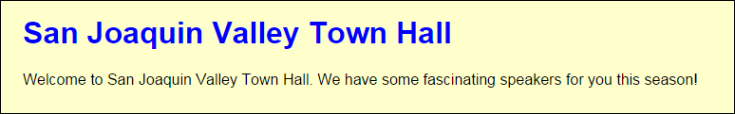
The hex colors in a web browser

Slide 15
Accessibility guideline for colors
Remember the visually-impaired.
Dark text on a light background is easier to read, and black type on a white background is easiest to read.

Slide 16
Three ways to code CSS3 colors
The syntax for RGBA colors
rgba(red%, green%, blue%, opacity-value)
The syntax for HSL and HSLA colors
hsl(hue-degrees, saturation%, lightness%)
hsla(hue-degrees, saturation%, lightness%, opacity-value)
The CSS3 values for colors
opacity-value
hue-degrees
saturation%
lightness%

Slide 17
Examples of CSS3 colors
h1 { color: rgba(0, 0, 255, .2) /* transparent blue */ }
h1 { color: hsl(120, 100%, 25%) /* dark green */ }
h1 { color: hsl(120, 75%, 75%) /* pastel green */ }
h1 { color: hsla(240, 100%, 50%, 0.5) /* semi- transparent solid blue */ }

Slide 18

The CSS3 colors in a browser

Slide 19
HTML that can be selected by element type, id, or class
<main>
<h1>This Season's Speaker Lineup</h1>
<p class="blue">October: Jeffrey Toobin</p>
<p class="blue">November: Andrew Ross Sorkin</p>
</main>
<footer>
<p id="copyright" class="blue right">Copyright 2018</p>
</footer>

Slide 20
CSS style rules by element type, id, and class
All elements
* { margin: .5em 1em; }
Elements by type
main {
border: 2px solid black;
padding: 1em; }
h1 { font-family: Arial, sans-serif; }
p { margin-left: 3em; }
One element by ID
#copyright { font-size: 80%; }
Elements by class
.blue { color: blue; }
.right { text-align: right; }

Slide 21

The elements displayed in a browser

Slide 22
HTML that can be selected by relationships
<main>
<h1>This Season's Town Hall speakers</h1>
<ul class="speakers">
<li>January: <a href="speakers/brancaccio.html">
David Brancaccio</a></li>
<li>February: <a href="speakers/fitzpatrick.html">
Robert Fitzpatrick</a></li>
<li>March: <a href="speakers/williams.html">
Juan Williams</a></li>
</ul>
<h2>Post-lecture luncheons</h2>
<p>Extend the excitement by going to the luncheon</p>
<p>A limited number of tickets are available.</p>
<p><em>Contact us by phone</em> at (559) 555- 1212.</p>
</main>

Slide 23
CSS style rules with relational selectors
Descendant
main li { font-size: 90%; }
ul a { color: green; }
Adjacent sibling
h2+p { margin-top: .5em; }
Child
main>p { font-size: 80%; }
li>a { color: green; }
General sibling (a new feature of CSS3)
h2~p { margin-left: 2em; }

Slide 24
Combinations of selectors
A selector for a class within an element
ul.speakers {
list-style-type: square;
}
Multiple selectors
h1, h2, h3 {
color: blue;
}
p, ul.speakers li {
font-family: "Times New Roman", serif;
}

Slide 25
Attribute selectors
All elements with href attributes
*[href] {
font-size: 95%;
}
All <a> elements with href attributes
a[href] {
font-family: Arial, sans-serif;
}
All input elements with type attributes that have a value of “submit”
input[type="submit"] {
border: 1px solid black;
color: #ef9c00;
background-color: #facd8a;
}

Slide 26
Common CSS pseudo-classes
:link
:visited
:active
:hover
:focus
Common CSS3 pseudo-classes
:first-child
:last-child
:only-child
Common CSS3 pseudo-elements
::first-letter
::first-line

Slide 27
HTML that can be used by pseudo-class and pseudo-element selectors
<main>
<p>Welcome to San Joaquin Valley Town Hall.</p>
<p>We have some fascinating speakers for you this season!</p>
<ul>
<li><a href="toobin.html">Jeffrey Toobin</a></li>
<li><a href="sorkin.html">Andrew Ross Sorkin</a></li>
<li><a href="chua.html">Amy Chua</a></li></ul>
</main>

Slide 28
The CSS for pseudo-class and pseudo-element selectors
a:link {
color: green;
}
a:hover, a:focus {
color: fuchsia
}
main p:first-child {
font-weight: bold;
}
main p:first-child::first-letter {
font-size: 150%
}

Slide 29
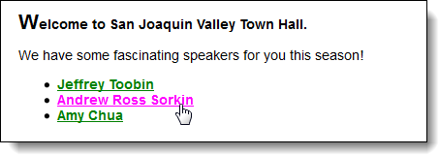
The pseudo-class and pseudo-element selectors in a browser

Slide 30
Accessibility guideline for :hover and :focus
Apply the same formatting to the :hover and :focus pseudo-classes for an element.
That way, those who can’t use the mouse will have the same experience as those who can.

Slide 31
The cascade order for applying CSS style rules
!important rules in a user style sheet
!important rules in a web page
Normal rules in a web page
Normal rules in a user style sheet
Default rules in the web browser

Slide 32
How to identify a rule as important
.highlight {
font-weight: bold !important;
}

Slide 33
If more than one style rule at a cascade level is applied to an element…
Use the style rule with the highest specificity.
If the specificity is the same for two or more style rules in a group, use the style rule that’s specified last.
How to determine the specificity of a selector
An id is the most specific.
A class, attribute selector, or pseudo-class selector is less specific.
An element or pseudo-element selector is least specific.

Slide 34
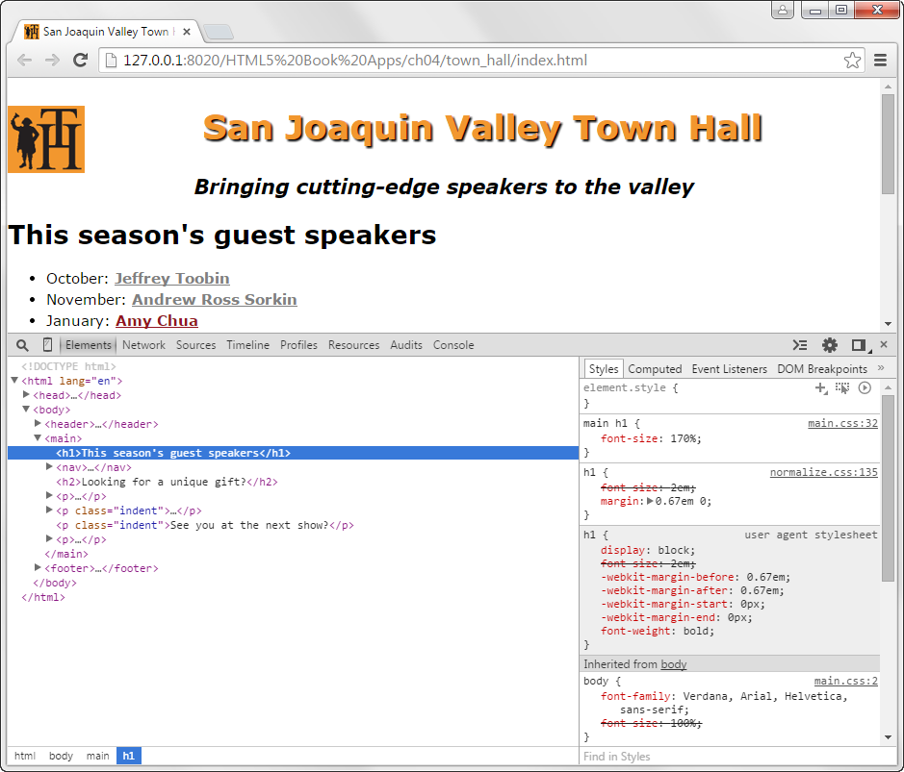
Cascading styles in Chrome’s developer tools

Slide 35
How to use Chrome’s developer tools
To display the panel for the tools, press the F12 key.
To inspect the styles that have been applied to an element, click on the element in the Elements pane at the left side of the developer tools panel.
The styles that have been applied to the selected element are displayed in the Styles pane at the right side of the developer tools panel.

Slide 36
The five generic font families
serif
sans-serif
monospace
cursive
fantasy

Slide 37
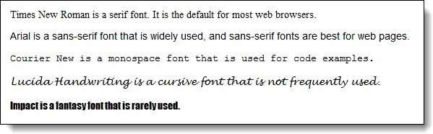
Examples of the five generic font families

Slide 38
How to specify a font family and font size
Font family
font-family: Arial, Helvetica, sans-serif;
font-family: "Times New Roman", Times, serif;
font-family: "Courier New", Courier, monospace;
Font size
font-size: 12pt; /* in points */
font-size: 150%; /* as a percent of the parent element */
font-size: 1.5em; /* same as 150% */

Slide 39
A font-family rule in the body element that is inherited by all descendants
body {
font-family: Arial, Helvetica, sans-serif;
font-size: 100%; }
A font-family rule in a descendent that overrides the inherited font family
p { font-family: "Times New Roman", Times, serif; }

Slide 40
Other properties for styling fonts
font-style
font-weight
font-variant
line-height

Slide 41
How to use the other properties for styling fonts
With font styles and variants
font-style: italic;
font-style: normal; /* remove style */
font-variant: small-caps;
With specify font weights
font-weight: 700;
font-weight: bold; /* same as 700 */
font-weight: normal; /* same as 400 */
font-weight: lighter; /* relative to the parent element */
With line heights
line-height: 14pt;
line-height: 140%;
line-height: 1.4em; /* same as 140% */
line-height: 1.4; /* same as 140% and 1.4em */

Slide 42
The shorthand font property
font: [style] [weight] [variant] size[/line-height] family;
How to use the shorthand font property
font: italic bold 14px/19px Arial, sans-serif;
font: small-caps 150% "Times New Roman", Times, serif;
font: 90%/120% "Comic Sans MS", Impact, sans-serif;

Slide 43
Properties for indenting, aligning, and decorating text
text-indent
text-align
vertical-align
text-decoration

Slide 44
The HTML for a web page that will use text indent and horizontal alignment
<header>
<h1>San Joaquin Valley Town Hall</h1>
</header>
<main>
<p>Welcome to San Joaquin Valley Town Hall. We have some fascinating speakers for you this season!</p>
</main>
<footer>
<p>&copy; Copyright 2018 San Joaquin Valley Town Hall.</p>
</footer>

Slide 45
CSS that specifies a text indent and horizontal alignment
body {
font-size: 100%;
margin: 2em;
}
h1 {
font-size: 180%;
}
main p {
text-indent: 2em;
}
footer p {
font-size: 80%;
text-align: right;
}

Slide 46

The formatted HTML in a web browser

Slide 47
The text-shadow property
text-shadow: horizontalOffset, verticalOffset, blurRadius, shadowColor;
A text shadow with no blur or color
The h1 element
<h1>San Joaquin Valley Town Hall</h1>
The CSS
h1 {
color: #ef9c00;
text-shadow: 4px 4px; }

Slide 48

The shadow with no blur or color in a browser

Slide 49
A text shadow with blur and color
The h1 element
<h1>San Joaquin Valley Town Hall</h1>
The CSS
h1 {
color: blue;
text-shadow: -2px -2px 4px red; }

Slide 50

The shadow with blur and a color in a browser

Slide 51
Accessibility guideline for shadows
Remember the visually-impaired. Too much shadow or blur makes text harder to read.

Slide 52

An image that has been floated to the left of the headings that follow

Slide 53
The HTML and CSS for the floated image
The HTML
<img src="images/logo.gif" alt="Town Hall Logo" width="80">
<h1>San Joaquin Valley Town Hall</h1>
<h2>Bringing cutting-edge speakers to the valley</h2>
The CSS
img {
float: left;
margin-right: 1em;
}
The property that will stop the floating
main {
clear: left;
}

Slide 54

The page if the image width is reduced to 40

Slide 55
The property that will stop the floating before a subsequent element
main { clear: left; }

Slide 56
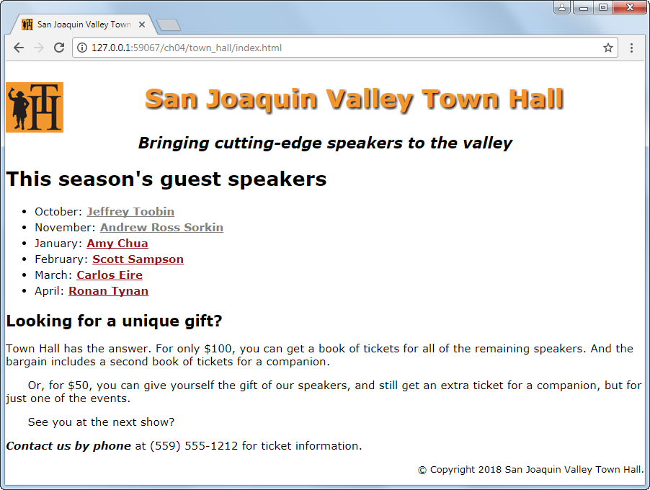
A web page that uses the styles of this chapter

Slide 57
The HTML file for the web page (part 1)
<!DOCTYPE HTML>
<html lang="en">
<head>
<title>San Joaquin Valley Town Hall</title>
<meta charset="utf-8">
<link rel="shortcut icon" href="images/favicon.ico">
<link rel="stylesheet" href="styles/normalize.css">
<link rel="stylesheet" href="styles/main.css">
</head>
<body>
<header>
<img src="images/logo.gif" alt="Town Hall Logo" width="80">
<h2>San Joaquin Valley Town Hall</h2>
<h3>Bringing cutting-edge speakers to the valley</h3>
</header>

Slide 58
The HTML file for the web page (part 2)
<main>
<h1>This season's guest speakers</h1>
<nav>
<ul>
<li>October: <a class="date_passed"
href="speakers/toobin.html"> Jeffrey Toobin</a></li>
<li>November: <a class="date_passed"
href="speakers/sorkin.html">Andrew Ross Sorkin</a></li>
<li>January: <a href="speakers/chua.html">
Amy Chua</a></li>
<li>February: <a href="speakers/sampson.html">
Scott Sampson</a></li>
<li>March: <a href="speakers/eire.html">
Carlos Eire</a></li>
<li>April: <a href="speakers/tynan.html">
Ronan Tynan</a></li>
</ul>
</nav>

Slide 59
The HTML file for the web page (part 3)
<h2>Looking for a unique gift?</h2>
<p>Town Hall has the answer. For only $100, you can get a book of tickets for all of the remaining speakers. And the bargain includes a second book of tickets for a companion.</p>
<p class="indent">Or, for $50, you can give yourself the gift of our speakers, and still get an extra ticket for a companion, but for just one of the events.</p>
<p class="indent">See you at the next show?</p>
<p><em>Contact us by phone</em> at (559) 555-1212 for ticket
information.</p>
</main>
<footer>
<p>&copy; Copyright 2018 San Joaquin Valley Town Hall.</p>
</footer>
</body>
</html>

Slide 60
The CSS file for the web page (part 1)
body {
font-family: Verdana, Arial, Helvetica, sans-serif;
font-size: 100%;
}
a { font-weight: bold; }
a:link { color: #931420; }
a:visited { color: #f2972e;}
a:hover, a:focus { color: blue; }
ul { line-height: 1.5; }
li, p { font-size: 95%; }
em { font-weight: bold; }
header img { float: left; }
header h2 {
font-size: 220%;
color: #f2972e;
text-align: center;
text-shadow: 2px 2px 2px black;
}

Slide 61
The CSS file for the web page (part 2)
header h3 {
font-size: 130%;
font-style: italic;
text-align: center;
}
main { clear: left; }
main h1 { font-size: 170%; }
main h2 { font-size: 130%; }
main p.indent { text-indent: 2em; }
main a.date_passed { color: gray; }
footer p {
font-size: 80%;
text-align: right;
}

Slide 62
Objectives
Applied
Given an HTML document, create a CSS style sheet for formatting the web page using any of the types of selectors or rules that are presented in this chapter.
Given an HTML document with one or more CSS style sheets applied to it, use the developer tools for your browser to inspect the styles.
Given a selector in the CSS for an HTML document, describe what the selector applies to.
Knowledge
Describe three ways to include CSS in a web page.
Explain why it’s usually best to use an external style sheet for formatting a page.

Slide 63
Objectives (continued)
Describe the purpose of the normalize.css style sheet.
Distinguish between absolute and relative units of measurement.
Describe three ways to specify color in CSS, and describe how CSS3 expands upon that.
Describe these types of selectors: universal, type, id, class, descendant, child, sibling, pseudo-class, and pseudo-element.
Describe one accessibility guideline for using pseudo-class selectors.
Explain how user style sheets, !important rules, and specificity are used in the cascade order for applying style rules.
Describe these properties for styling fonts: font-family, font-style, font-weight, font-size, and line-height.
Describe these properties for formatting text: text-indent, text-align, text-decoration, and text-shadow.

